Slide 1

DIGITAL SIGNAGE SOLUTIONS

Slide 2
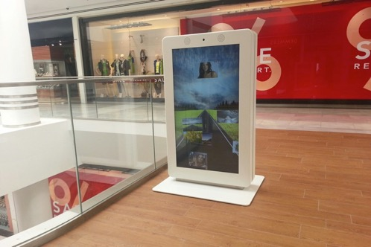
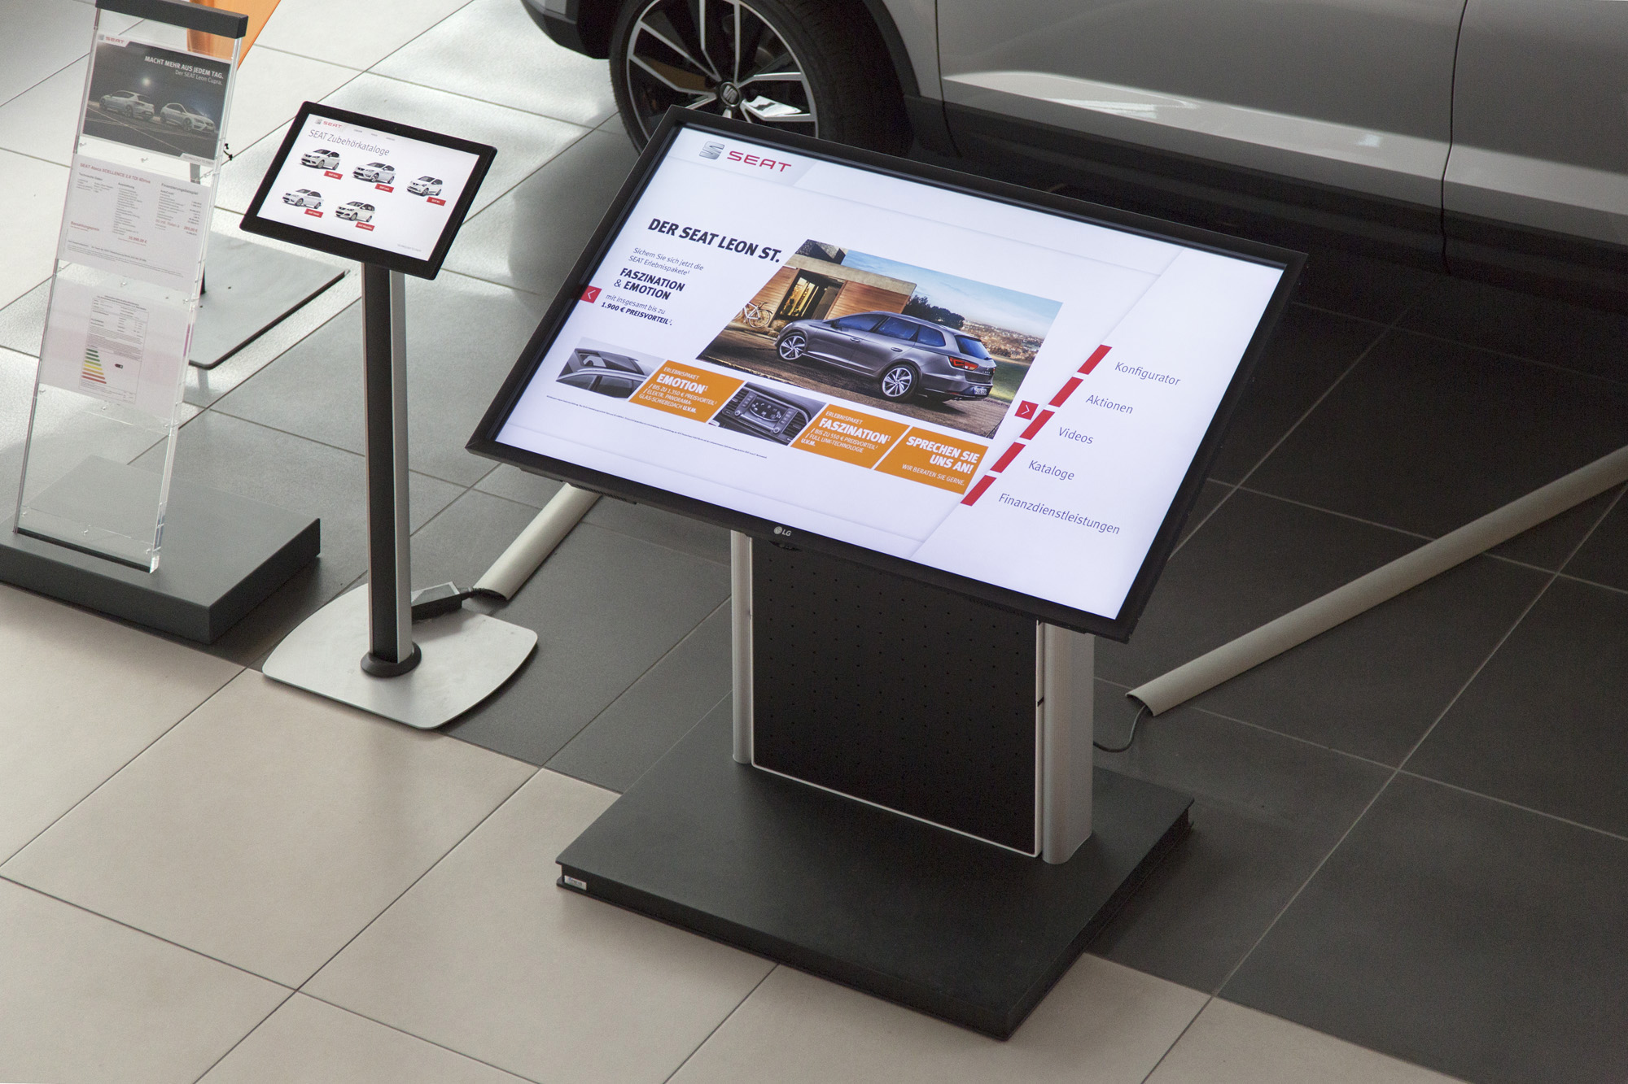
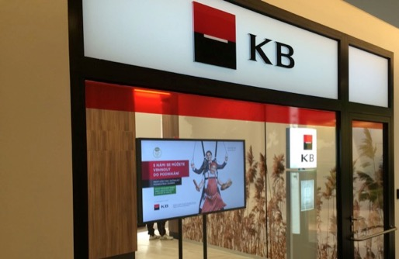

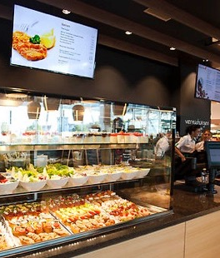
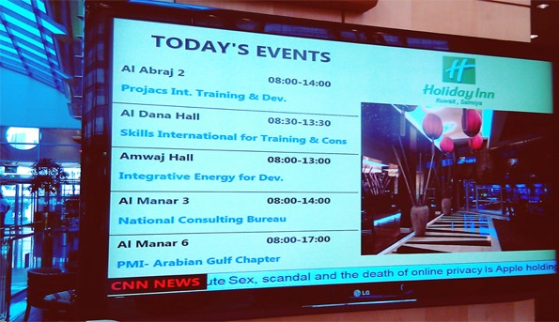
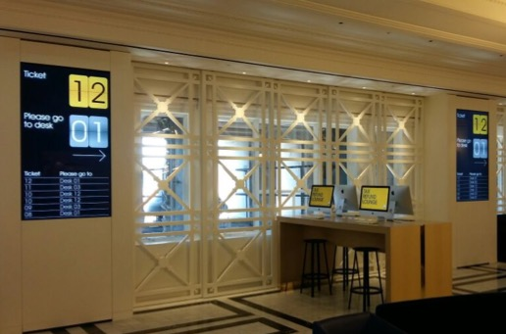
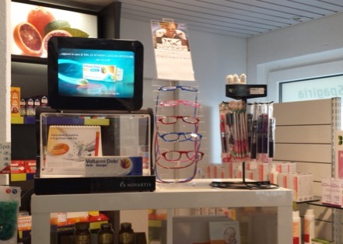
STiNO Solutions for Vertical Market Segments
Shopping Malls
Car Dealers
Banks
DooH
Menu Boards
Hotels
Authorities
Pharmacies

Slide 3
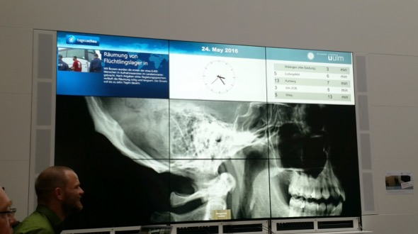
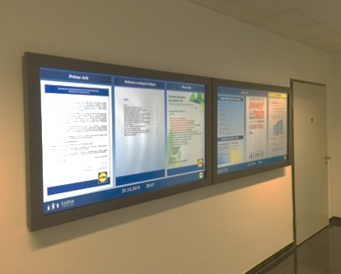
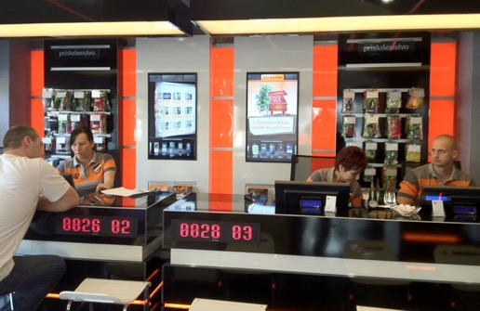
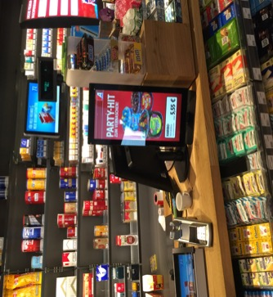
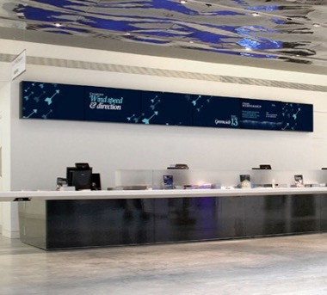
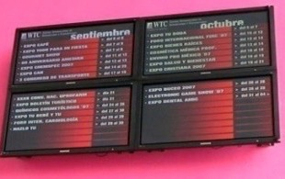
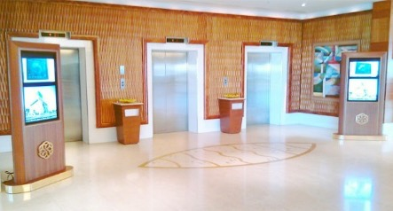
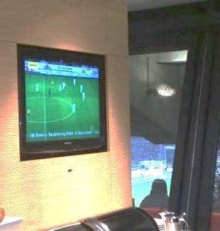
STiNO Solutions for Vertical Market Segments
Education
Whiteboards
Telecom Retail
Gas Stations
Museums
Event Locations
Hospitals
Stadiums

Slide 4

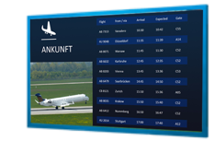

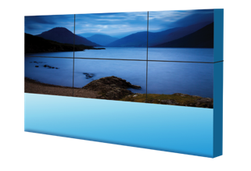


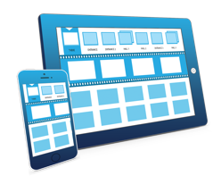

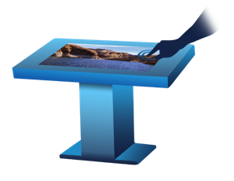


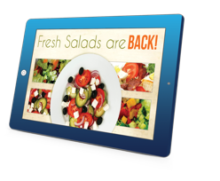
Central Management for a Multitude of Devices
LFD
iChannel Server
Local
or public Cloud
Video Wall
App-based Management
Touch
Console
InStore Radio
Kiosk
Totem
Tablet
Small Displays
WEB-based Management

Slide 5



Product Overview
WEB-based Digital Signage Management Software | Android App-based Digital Signage Management Software | Interactive Kiosk and Presentation Software | Software for Door Signage
Server for Linux, VMware, Windows 7/10, Raspberry | Management for Android | For Windows 7/10 | For Android
Player Software for Windows 7/10, Android, HTML 5 (SoC LG, Samsung, Toshiba) | Player Software for Android and Windows 7/10 | Player Software for Windows 7/10 | Player Software for Android
As cloud subscription or on-premises license | As stand-alone on-premises license or as management client for iChannel CMS | As stand-alone on-premises license or as MultiTouch extension for iChannel CMS | As stand-aone on-premises license or extension for iChannel CMS

Slide 6
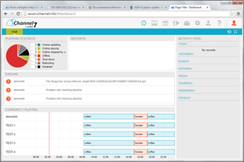
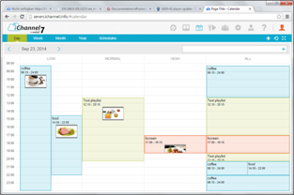
Server Software Features
The iChannel server software platform is STiNO‘s CMS solution for Digital Signage in the 7th generation supporting a multitude of features to accomplish the manifold requirements of digital signage and visual marketing applications. In the following you will see only some of our core features:
WEB based system architecture for on-premises or cloud usage
Scalable from an embedded server (Raspberry), local Windows PC up to a virtualized server image based on Linux OS
Support for HTML5 (SoC), Android or Windows based playout devices
Dashboard to see the status of your digital signage network and server messages
Content repository management and WYSIWYG playlist editor
Support for formats such as images, videos, audios, text, RSS ticker, browser, HTML widget, XML sources, multicast, PDF, PPT(X)

Slide 7
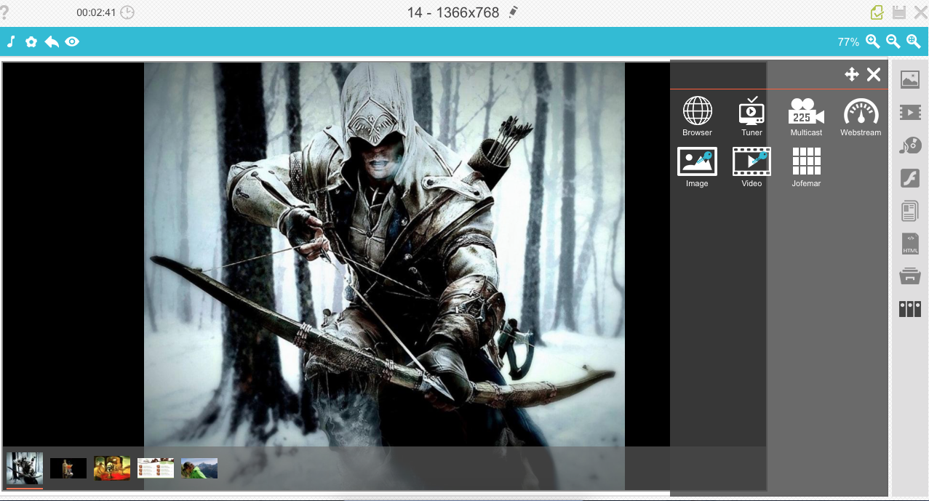
Server Software Features
The iChannel server software platform is STiNO‘s CMS solution for Digital Signage in the 7th generation supporting a multitude of features to accomplish the manifold requirements of digital signage and visual marketing applications. In the following you will see only some of our core features:
Calendar and campaign management with priority and meta data based playout
Player management with meta data based grouping
Assigning user and roll permissions
Auto-content folder for easy content change and deployment
Multi-account option for Digital Signage network operators
Optional support for kiosk and multi touch playlists for interactive applications

Slide 8







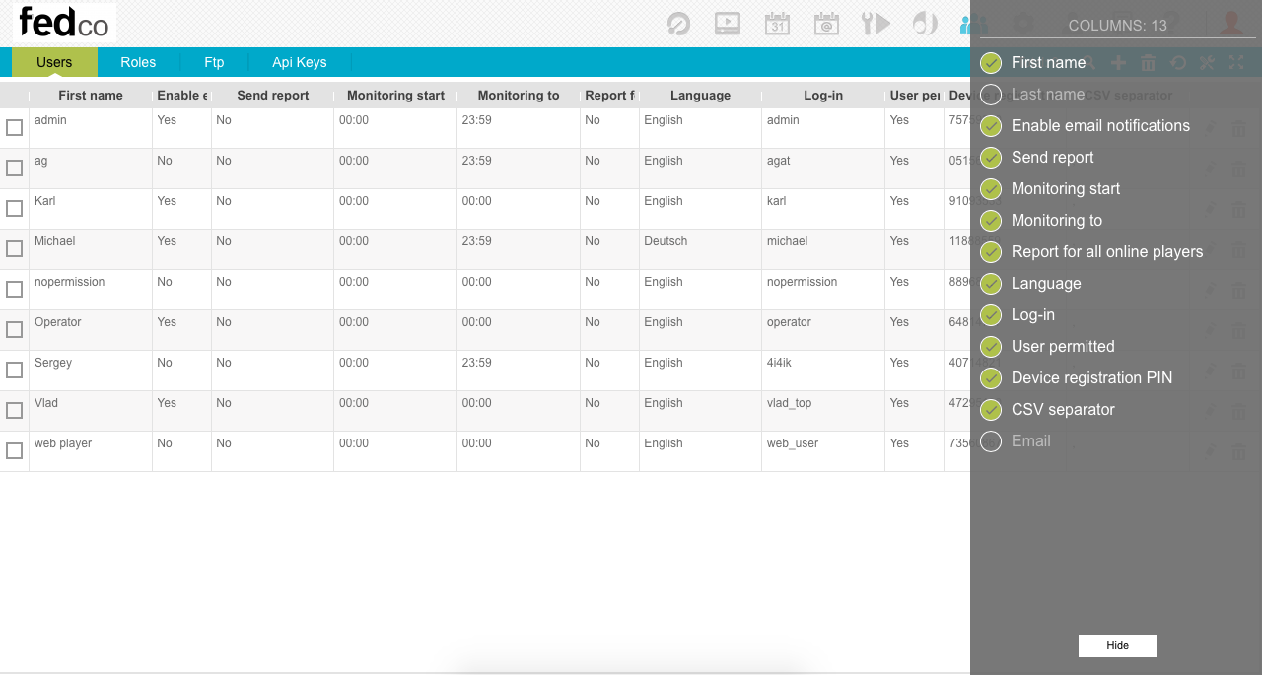
DMP-W Windows Player Software
Digital Media Player Software for Windows PC supports next features:
Windows 7/10
Various content formats such as images, videos, text, RSS ticker, HTML, multicast, PDF, PPT(X)
Watchdog with auto-update function
Screenshot function
Full-screen, single and multi-slide playlists
Interactive menu and multi touch playlists
Animated text and image objects
Image overlays on top of video
Portrait screen rotation
Video Wall with multi-headed graphic cards
Scheduled screen on/off via RS232

Slide 9


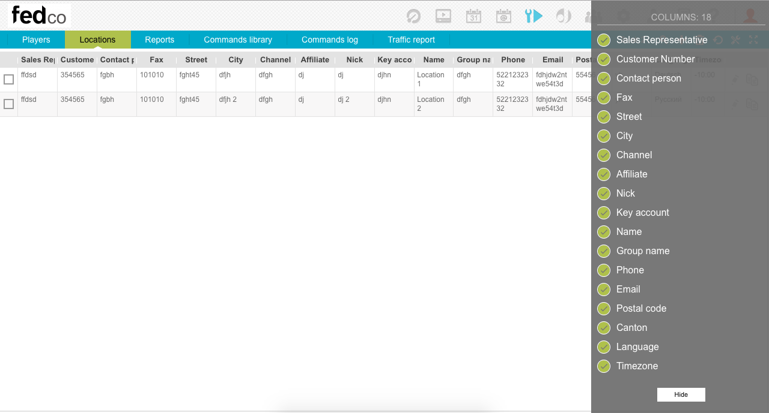
DMP-A Android Player Software
Digital Media Player Software for Android Media Player or all-in-one Tablets supports next features:
Android 4.x, 5.x, 6.x
Various content formats such as images, videos, audios, text, RSS ticker, HTML
Screenshot function
Full-screen, single and multi-slide playlists
Interactive menu playlists
Animated text and image objects
Image overlays on top of video
Portrait screen rotation
Scheduled screen on/off via RS232
STiNO Launcher to lock down Android for interactive applications

Slide 10
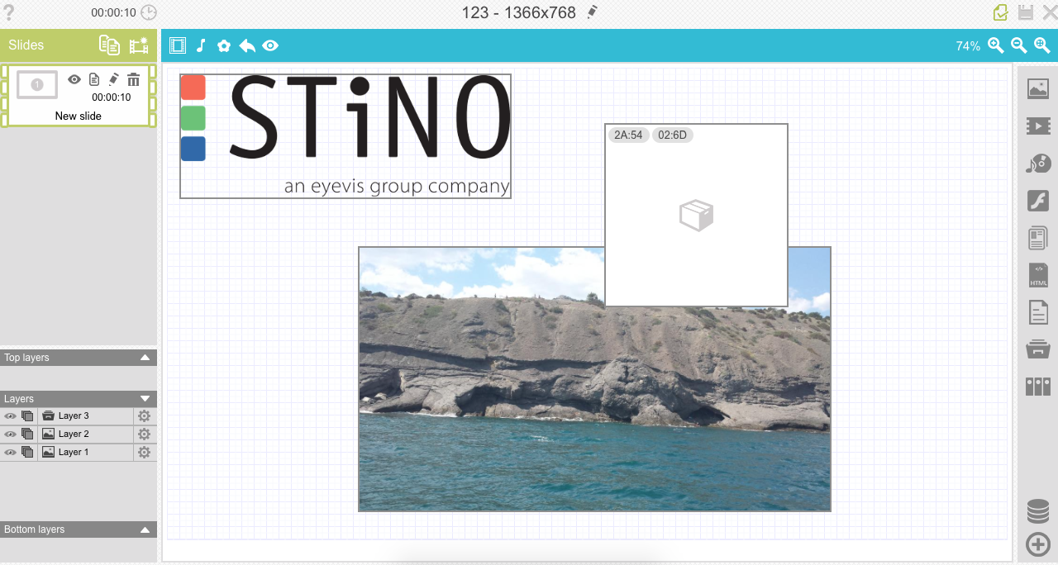
DMP-H SoC HTML5 Player Software
Digital Media Player Software for
HTML5 based Screens with SoC Players supports next functions:
Could be implemented at Samsung 4.0 Tizen and 3.0, LG WebOS 3, Toshiba SoC
Various content formats such as images, videos, text, RSS ticker, HTML, Flash
Screenshot function
Full-screen, single and multi-slide playlists
Animated text and image objects
Image overlays on top of video
Portrait screen rotation (if supported by SoC player firmware)
Scheduled screen on/off

Slide 11

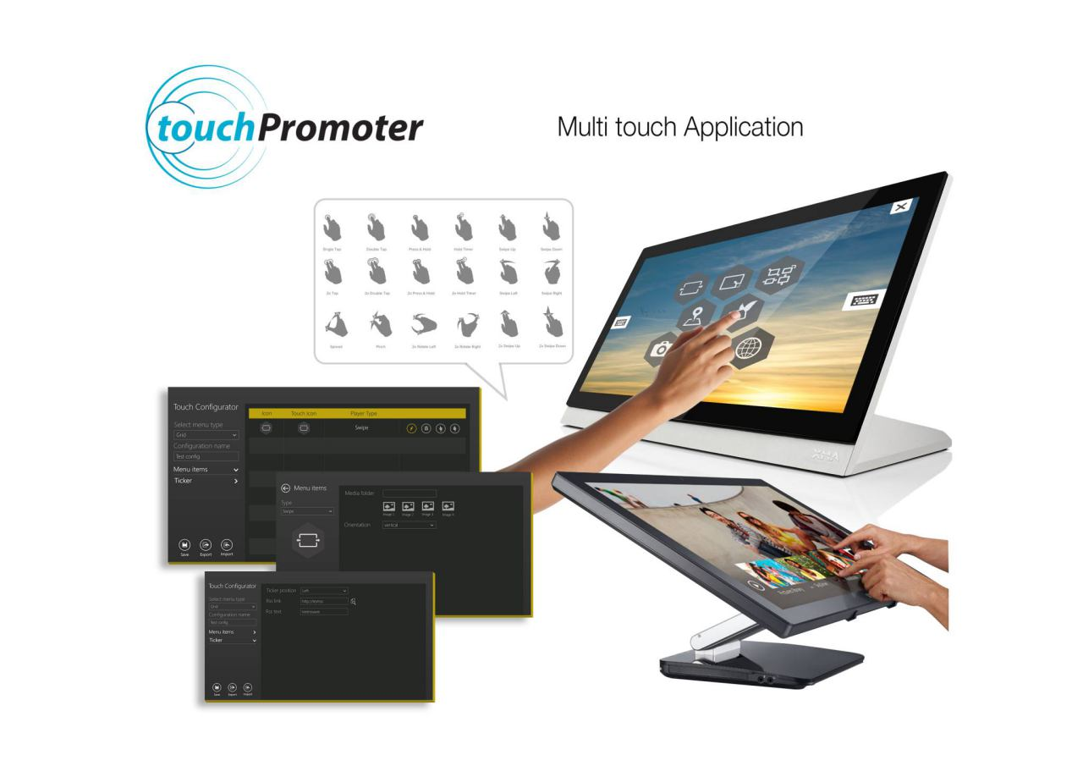
DMP-W Windows MultiTouch Application
Interactive MultiTouch Apps for Windows PC
Support for Windows 7/10
Multi-menu support for tiles, wheel, custom position
Variety of different Apps for presentation of content such as:
  Swipe App (Images, Videos)
  Book Flip App (PDF, Images, Videos)
  Fly App (Images, Videos)
  Puzzle App (Images, Videos)
  Table App (Images, Videos)
  Kiosk Browser App (Awesomium or IE Browser Engine)
  Google Maps
RSS and text ticker configurable in menu screen
Available as stand-alone solution or via iChannel CMS extension

Slide 12
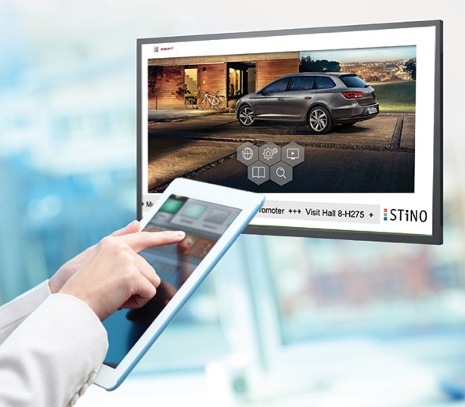
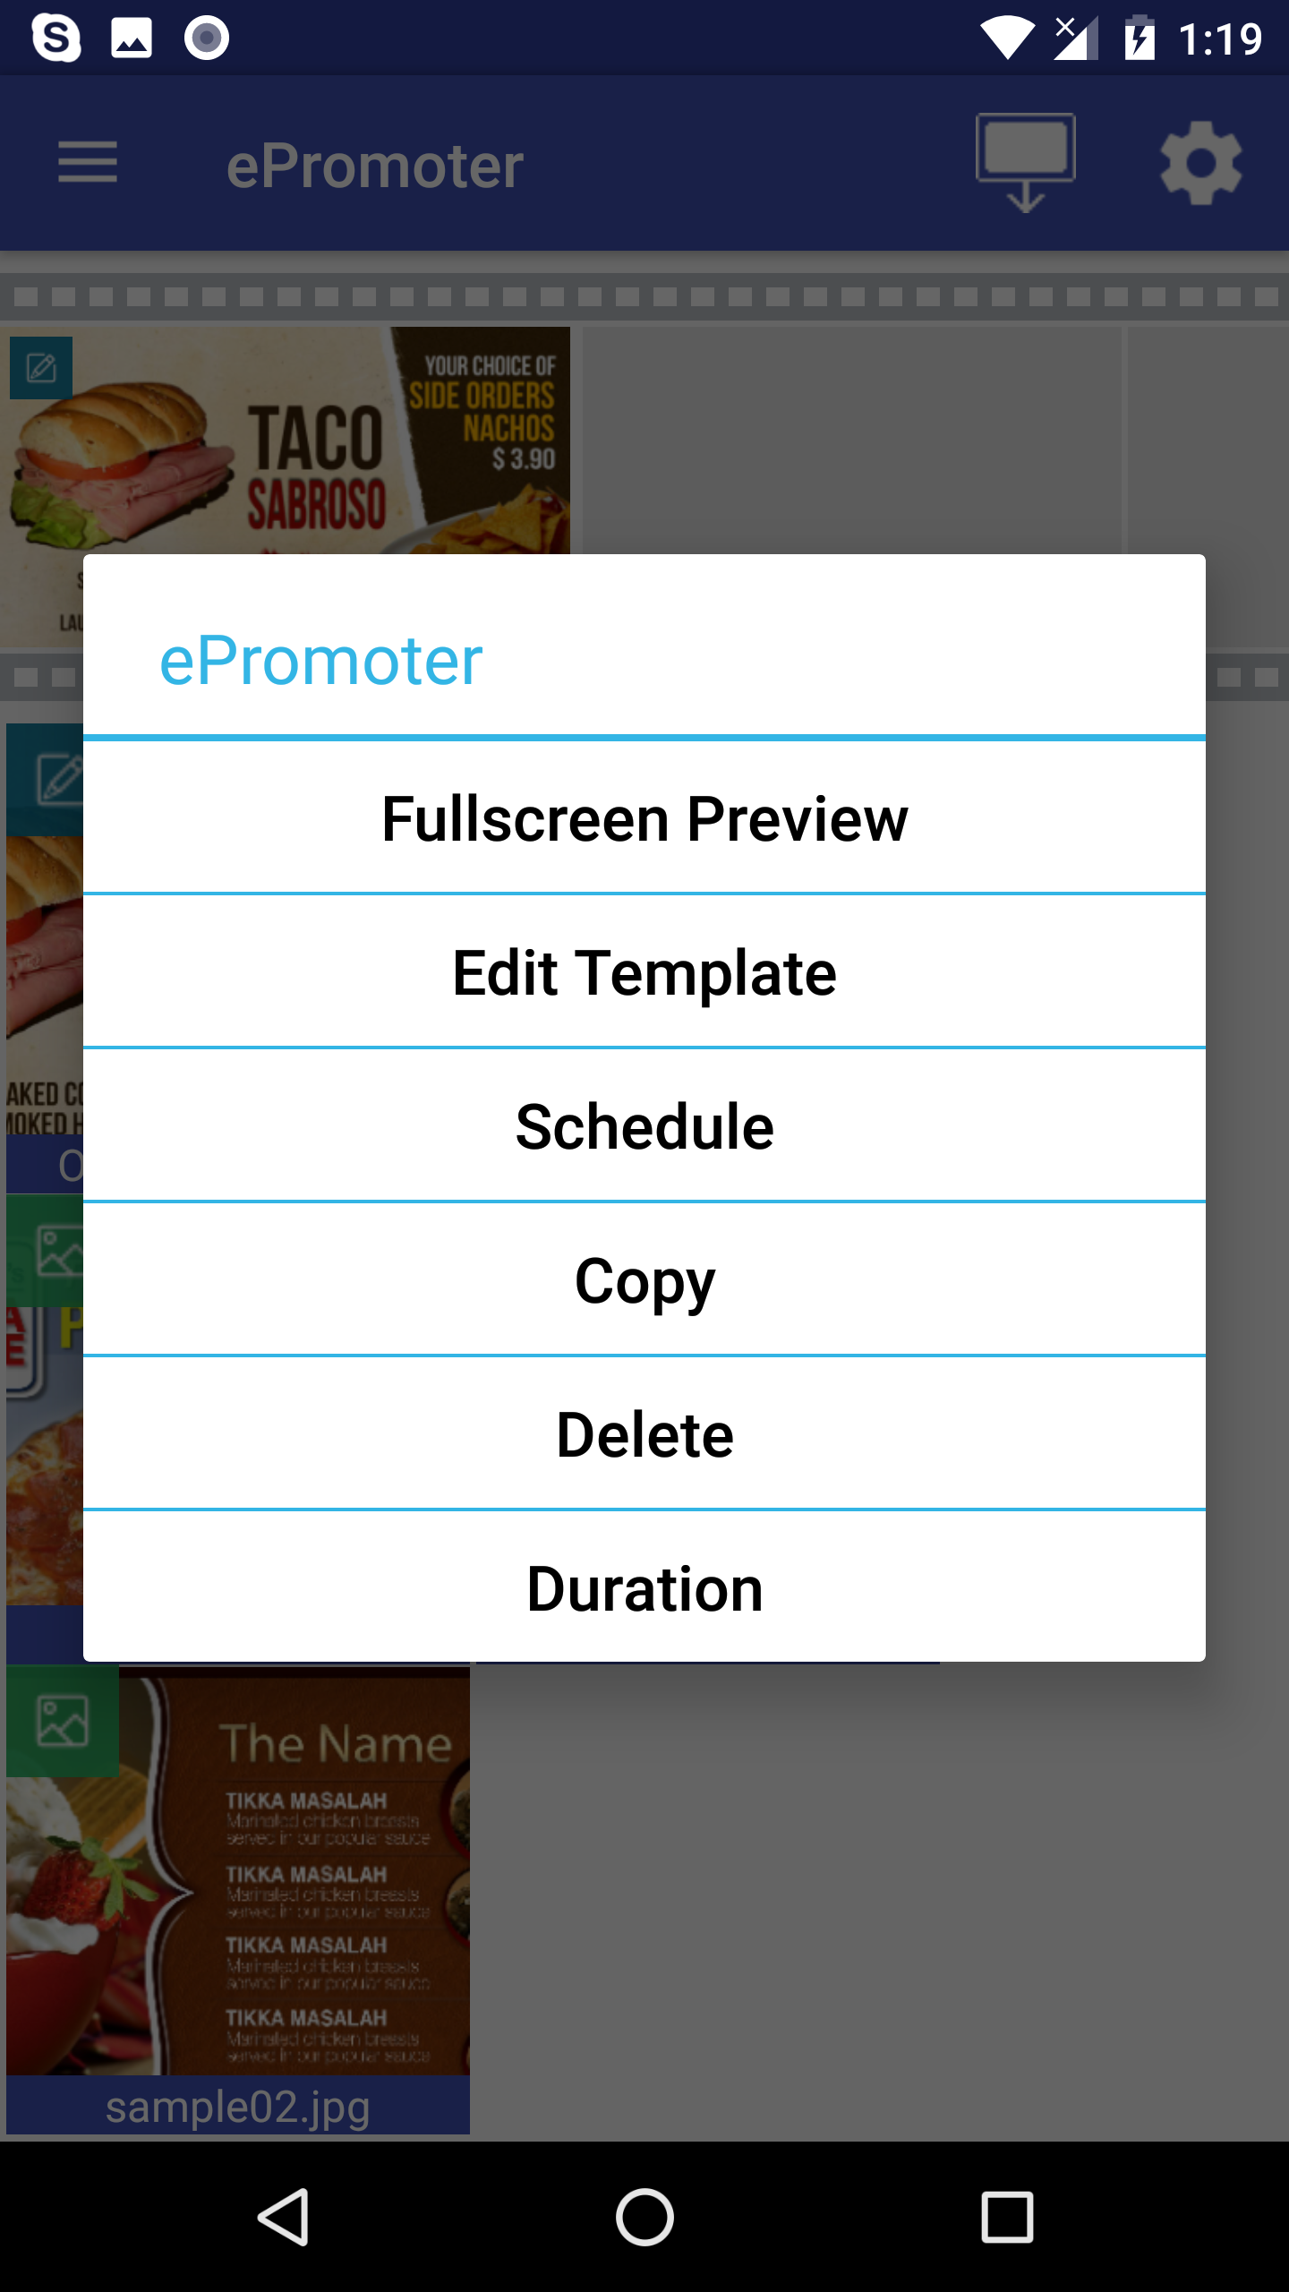
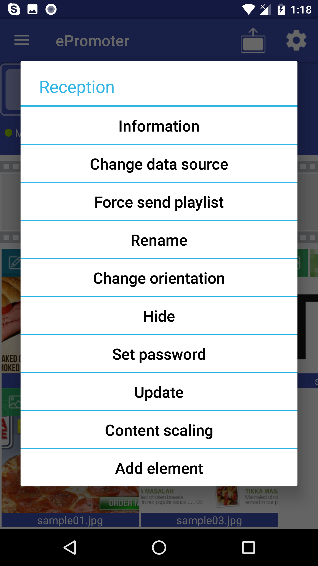
for Easy Content Management
ePromoter as a stand-alone solution or as simplified frontend in combination with iChannel CMS
ePromoter can be installed on any Android based smart phone or tablet computer
ePromoter can manage Android DMP or Windows DMP players in the local network
Easy to use software interface does not require any software training
Support for full-screen playlists with images, videos and HTML5 templates
Support for RSS text ticker overlay
Easy publishing of content library to the smart phone or tablet via Dropbox
Support for scheduling of each content element
Can be used in combination with iChannel to interrupt the playlist with pre-loaded ad-hoc content for a single play-out
Can be used in combination with iChannel to change play-out of elements of a playlist for example if goods are sold out in some stores

